Slide 1
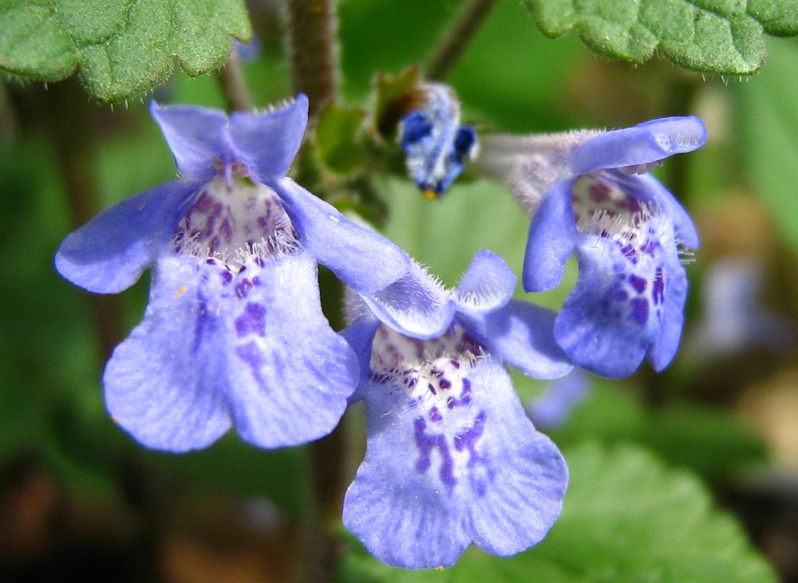
Lamiaceae

Slide 2
Material:
Class Magnoliopsida
Order Lamiales
Family Lamiaceae (mint family),
representatives:
Genus Salvinia, Salvinia sp.
Genus Mentha, Mentha arvensis sp.
Objective: To investigate the structural features of flowers of
Salvinia sp., Mentha sp.
Tasks of work
Salvinia: consider and draw the appearance of plant. Consider and draw the view of perianth from below side, longitudinal section of a flower, note on a cone-like receptacle and the location of the parts of a flower, fruit (aggregate achenes). Write a floral formula.
Mentha: consider and draw the side view of flower, rear sepal with a spur, a stamen, fruit (follicles). Write a floral formula.

Slide 3
Lamiaceae, formerly called Labiatae, the mint family of flowering plants, with 236 genera and more than 7,000 species, the largest family of the order Lamiales. Lamiaceae is distributed nearly worldwide, and many species are cultivated for their fragrant leaves and attractive flowers. The family is particularly important to humans for herb plants useful for flavour, fragrance, or medicinal properties..
Most members of the family are perennial or annual herbs with square stems, though some species are woody shrubs or subshrubs. The leaves are typically simple and oppositely arranged; most are fragrant and contain volatile oils. The flowers are usually arranged in clusters and feature two-lipped, open-mouthed, tubular corollas (united petals) with five-lobed bell-like calyxes (united sepals). The fruit is commonly a dry nutlet.

Slide 4
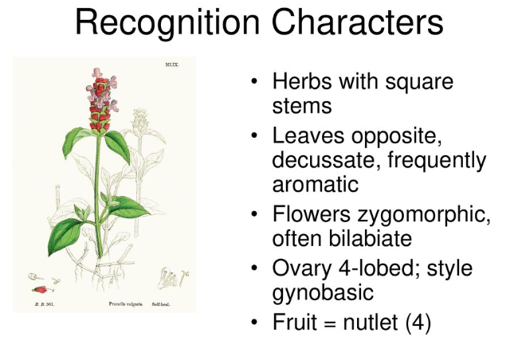

Slide 5
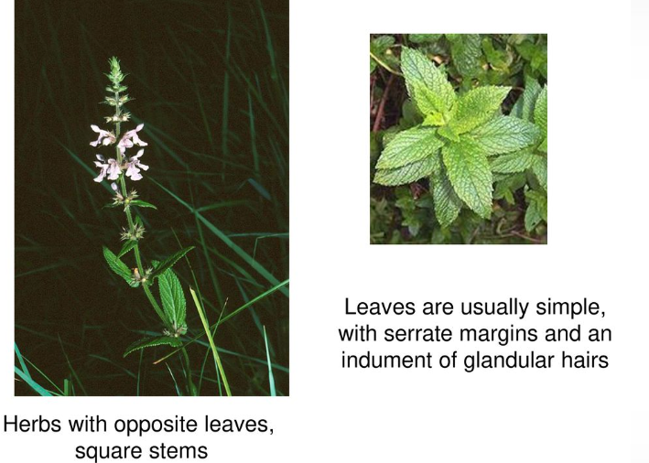

Slide 6
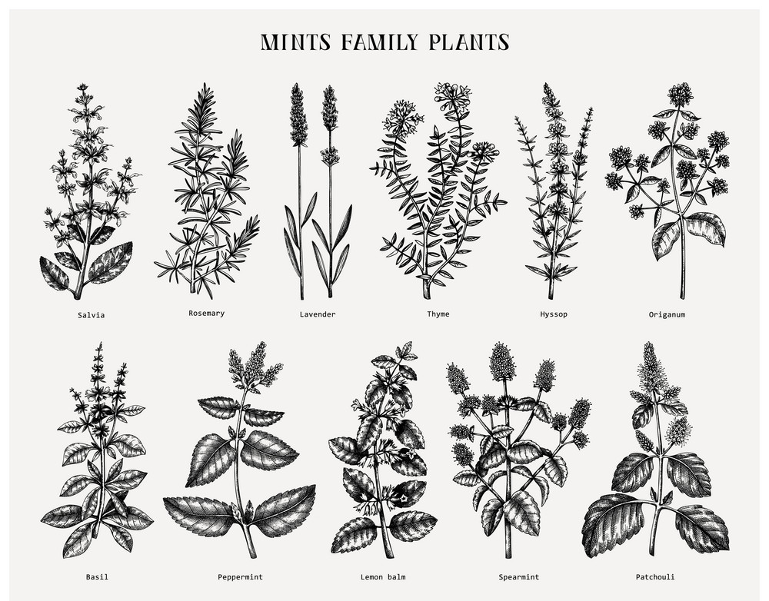

Slide 7
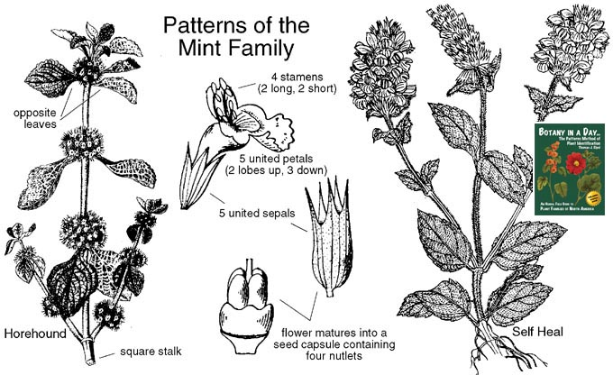

Slide 8
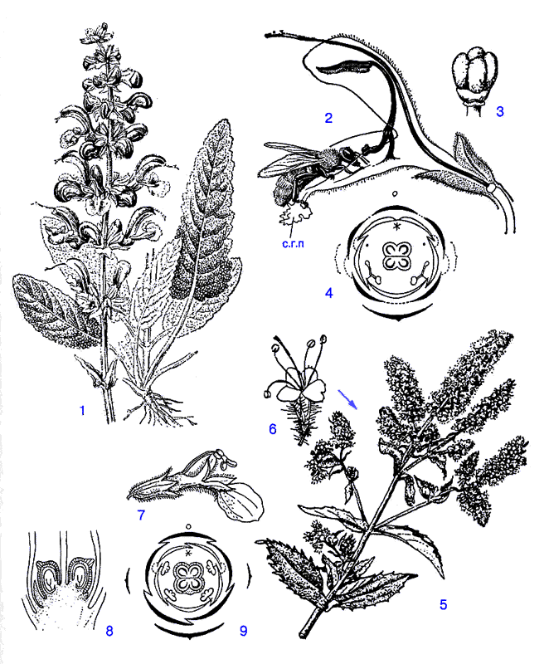
Formula of plant
Diagram of planr
Шалфей
Крапива

Slide 9
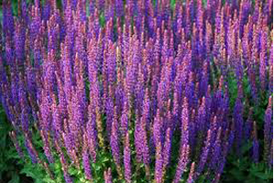
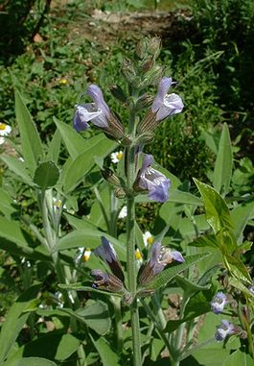
Salvia officinalis L., 1753
Домен: | Eucaria
Kingdom : | Plantae
Phylum: | Magnoliophyta
Class: | Dicotyledon
Order: | Lamiales
Family: | Lamiaceae
Род: | Salvia
Вид: | Salvia officinalis
The morphological structure of a plant

Slide 10
Practical significance
Many Lamiaceae contain valuable essential oils used in perfumery and food production. Peppermint is very widely used, as spices, the use of such representatives of lamb as basil, marjoram, savory, hyssop, rosemary, lavender, oregano, sage, lemon balm, thyme is very common. Lavender and rosemary are introduced into the culture and are grown commercially.Various types of sage, rosemary, lavender are known as ornamental plants and are used for landscaping settlements.Some members of the family are honey-bearing and are bred in apiaries, for example, basil, catnip, shandra, lemon balm, motherwort, chistets, mint, sage, lamb.Motherwort is widely used as a medicinal plant that reduces blood pressure and normalizes the functioning of the heart, and is cultivated for this purpose, including on an industrial scale. Many other plants of the family are also medicinal.

Slide 11
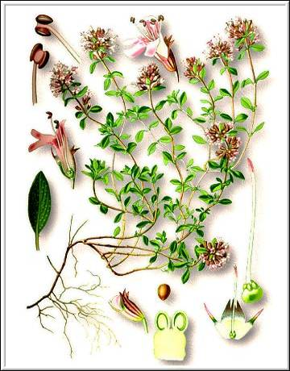
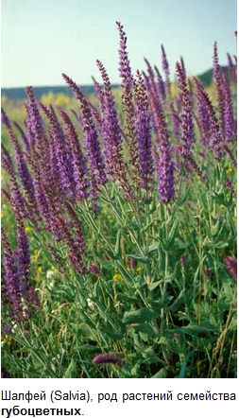
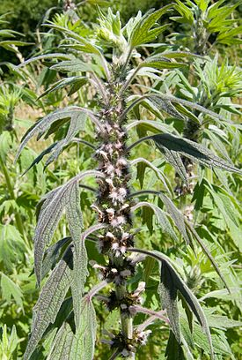
species used in medicine. For example, motherwort, sage, thyme, etc

Slide 12
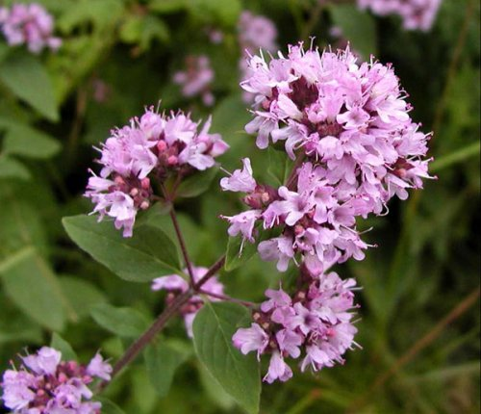
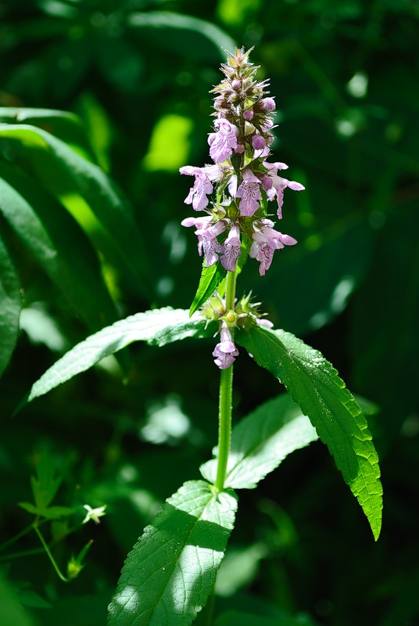
Honey plants
Oregano, thyme, chistets.

Slide 13
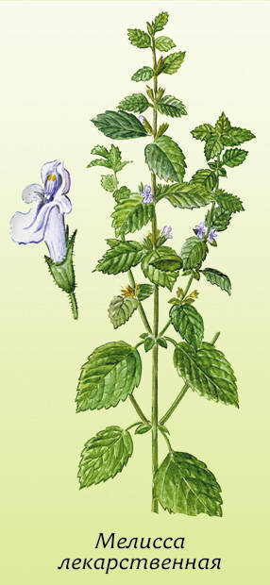
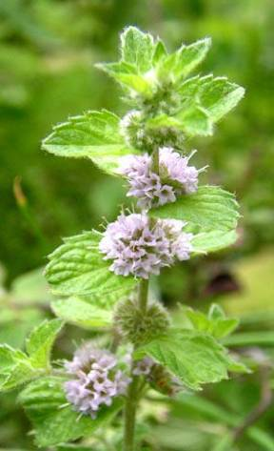
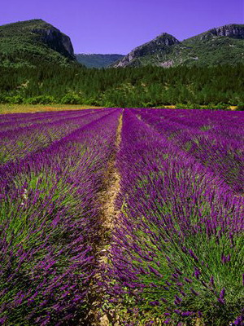
Types that are used for flavoring confectionery and perfumery products.
Mint, lavender, lemon balm.

Slide 14
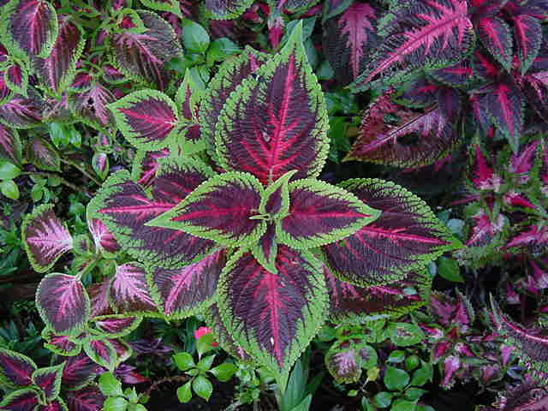
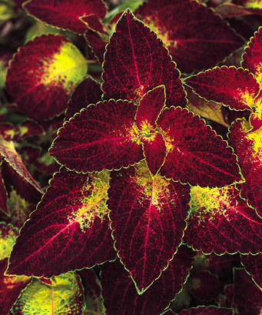
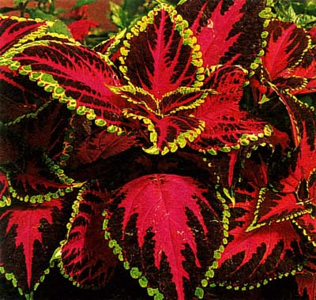
Decorative value..
Coleus

Slide 15
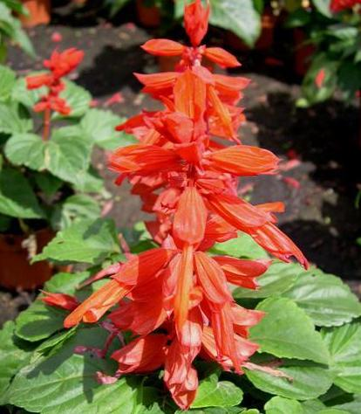
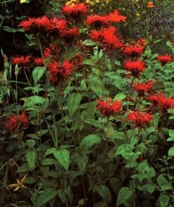
Sage and Monarda.

Slide 16
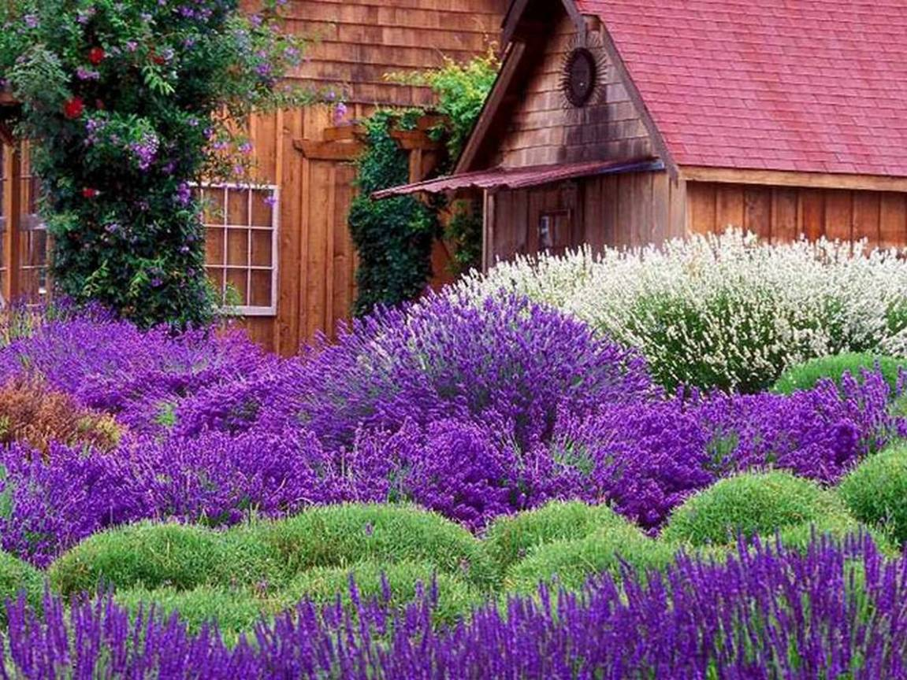

Slide 17
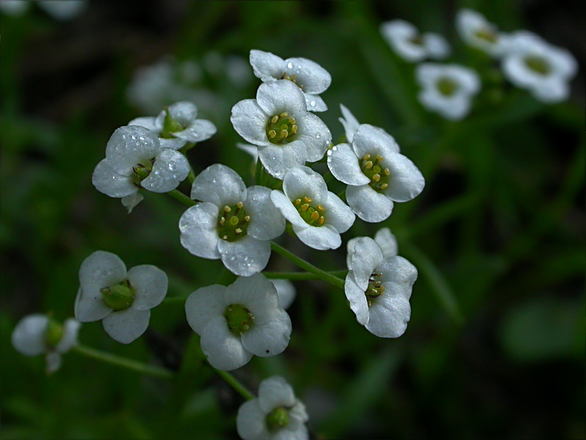
Family Brassicaceae

Slide 18
Material:
Class Magnoliopsida
Order Brassicales
Family Brassicaceae (mint family),
representatives:
Genus Thláspi, Brassica
Genus Thláspi arvénse, Brassica juncea .
Objective: To investigate the structural features of flowers of
Thláspi arvénse
Tasks of work
Thláspi arvénse: consider and draw the appearance of plant. Consider and draw the view of perianth from below side, longitudinal section of a flower, note on a cone-like receptacle and the location of the parts of a flower, fruit (aggregate achenes). Write a floral formula.
Brassica juncea : consider and draw the side view of flower, rear sepal with a spur, a stamen, fruit (follicles). Write a floral formula.

Slide 19
3. Vegetative characters
a) Habit
Mostly annual (Brassica), biennial (Raphanus), or perennial (Cheiranthus)
Mostly herbs, rarely under shrubs (Farsetia)
Mostly terrestrial and sometimes aquatic (pani sag)
Parts produce a pungent watery juice having sulfur smell.
b) Root
Roots are swollen sometimes and modified into various forms due to the storage of reserve food (fusiform and napiform) e.g. radish and turnip.

Slide 20
c) Stem
Aerial erect, cylindrical, hairy, branched or unbranched, mostly herbaceous, rarely woody.
Stem reduced (Brassica rapa, B. napus, and Raphanus sativus).
Stellate unicellular hairs are commonly present.
d) Leaves
Cauline and ramal, sometimes radical (Raphanus sativus), exstipulate, alternate, simple, rarely pinnately compound (Nasturtium officinale).
Margin entire or divided, sometimes dentate.
Often sessile and auriculate in the floral region. The radical leaves form the rosettes on the reduced stem.
Lower leaves petiolate and lyrate in some cases, e.g., mustard.
Venation- reticulate unicostate.

Slide 21
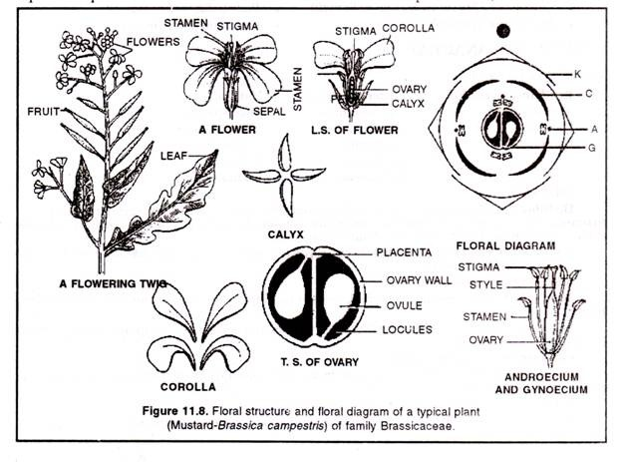

Slide 22
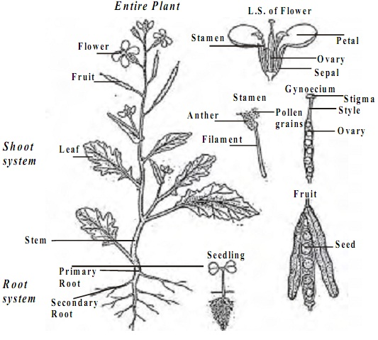

Slide 23
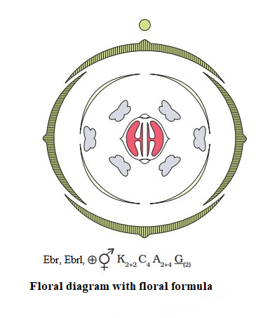

Slide 24
4. Floral characters
i) Inflorescence
Racemose-raceme, corymb or corymbose raceme.
ii) Flower
Pedicellate, ebracteate, bracts present in Nasturtium montanum.
Complete, bisexual, actinomorphic, Zygomorphic in Iberis amara (candytuft), hypogynous, and tetramerous.

Slide 25
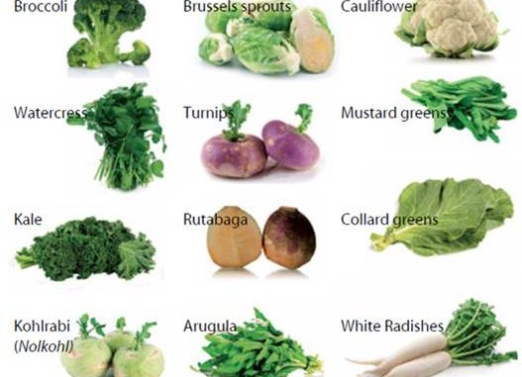

Slide 26
vii) Fruit
Siliqua or silicula, sometimes achene like and one-seeded.
viii) Seed
Contains large embryo, little or no endosperm and cotyledons are oily.

Slide 27
Economic importance
The members of this family are used for various purposes. They are as follows:
1. Food crops
Root of Raphanus sativus (radish), Brassica rapa (turnip), stem of B. caulorapa (vern. Gyanth gobi), leaves of B. oleraceae var. capitata cabbage, B. juncea (rayosag) and inflorescence of B. oleraceae var. botrytis (cauliflower) are used as vegetables.
2. Oil
Brassica compestris (sarson), B. napus (tori), B. rapa (turnip), etc are used for extraction of oils.
3. Spices
Seeds of B. nigra (black mustard), B. hirta (white mustard) and B. juncea (indian mustard) are used as spices.
4. Medicines
Seeds of Iberis amara (candytuft), Rorippa indica are used in asthma.
The flowers of Cheiranthus cheiri are used to cure mild paralysis and its seeds are used for curing bronchitis, fever and eye injuries.
5. Ornamentals
Some species are used as ornamental plants in the garden.
These are Iberis amara, Cheiranthus, Arabis, Hesperis, Lunaria, Mathiola incana, Nasturtium, etc.

Slide 28

